Slide 1
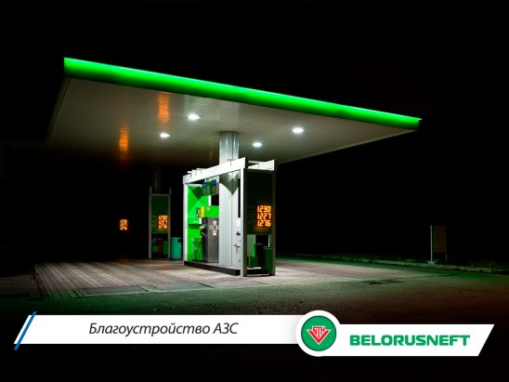

BelorusNeft Sales DWH
design and development
Olga Hilko, phD
December 2, 2017

Slide 2

DWH BelorusNeft
Extream programming
Belarus Petrol station network
December, 2 2017

Slide 3
DWH BelorusNeft
Mission of the project
is the development of the information system, which helps in accounting for the sold fuel across the whole network
Grain
Transaction (fact of payment) on payed amount of fuel on a certain date

Slide 4
DWH BelorusNeft
New DWH structure is going to meet the following advantages:
making the data exchange faster, more securable and flexible,
implementing integration of the source data from application systems of separate PSs,
increasing productivity of corporate decision-makers in advertisement and management,
enhancing customer service,
providing better enterprise intelligence .

Slide 5
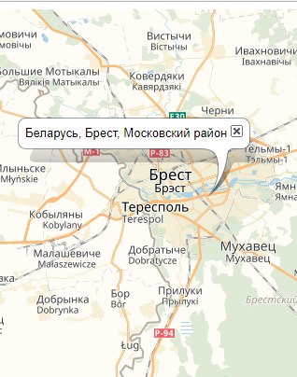
Sources
AZS – real data on 547 PSs
GEO – real classificatory (SOATO) with >26 000 records
CUSTOMERS – real data on 2200 entrepreneur and organizations and generated 100 000 persons
Fuel types and payment types – manualy set
Notes:
P37 – divide into 2 slides

Slide 6
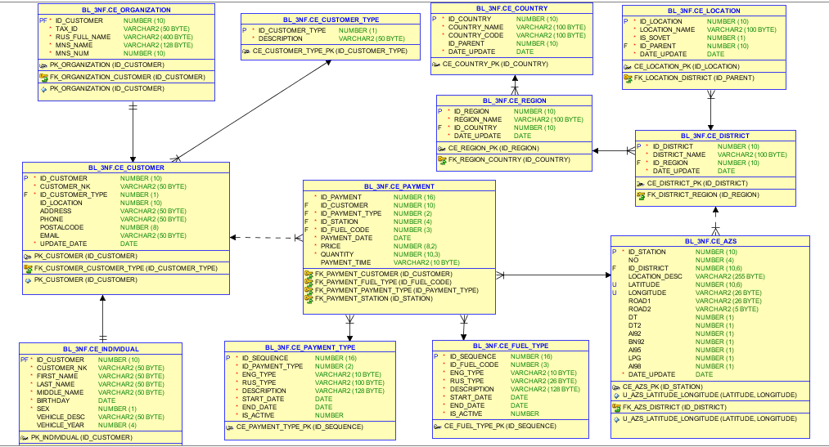
3NF LAYER

Slide 7
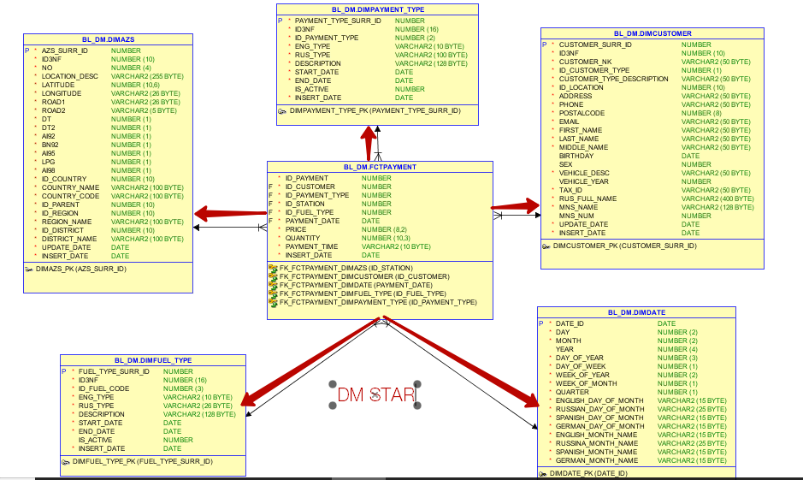
DM LAYER

Slide 8
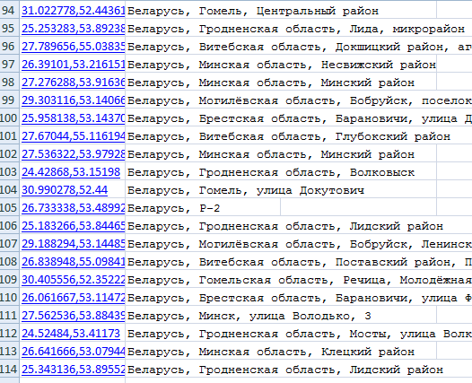

Challenges
No link between address and location
Repeatable data in GEO
Complex 3NF structure
Short time for development
Solution – JSON/XML by Yandex
using reverse geocoding
Analysis of SOATO codes,
data partition

Slide 9
Features
Using framework for repeatable code operations
Data on Russian
Logging errors and load process
Using SQL+PL/SQL+Dynamic SQL with parameters
Orchestral script for creating schemas, packages, ddl and dml
Partition in fact table
Ready to DEADLINE!

Slide 10
Gratefulness
1
Nikita Kondratuk and Il’ya Norkin
2
Maryna, Valeria, Arina, Sasha and Anya
3
BI Dream Team 2017 and my husband for moral support

Slide 11
THANKS
for your
attention!

